Slide 1
Preparing for Budget Development
GO Team Meeting #4

Slide 2
Agenda
Fall ACES Presentation
Review of Strategic Plan and priorities progress
Preparing for the Budget Development
Rank Strategic Priorities

Slide 3

Accountability
Collaboration
Equity
Support
NOTE to Principal: Please insert your ACES presentation after this slide.
Fall 2022 ACES Presentation

Slide 4
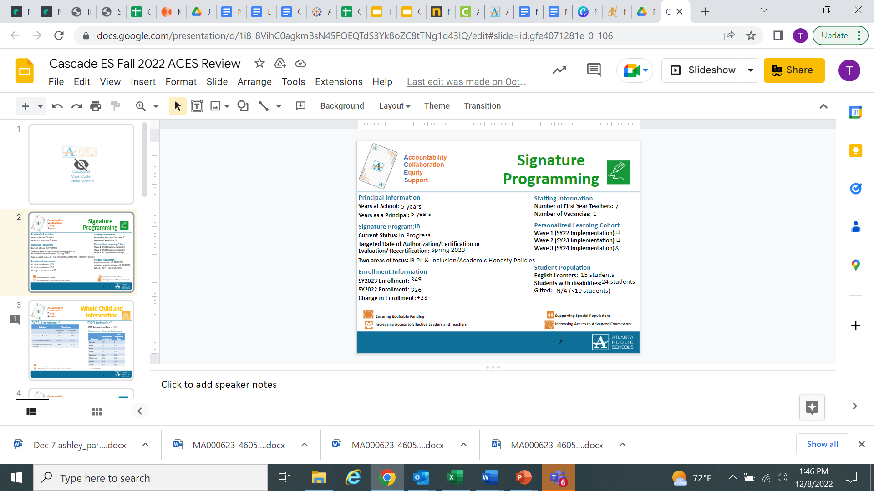
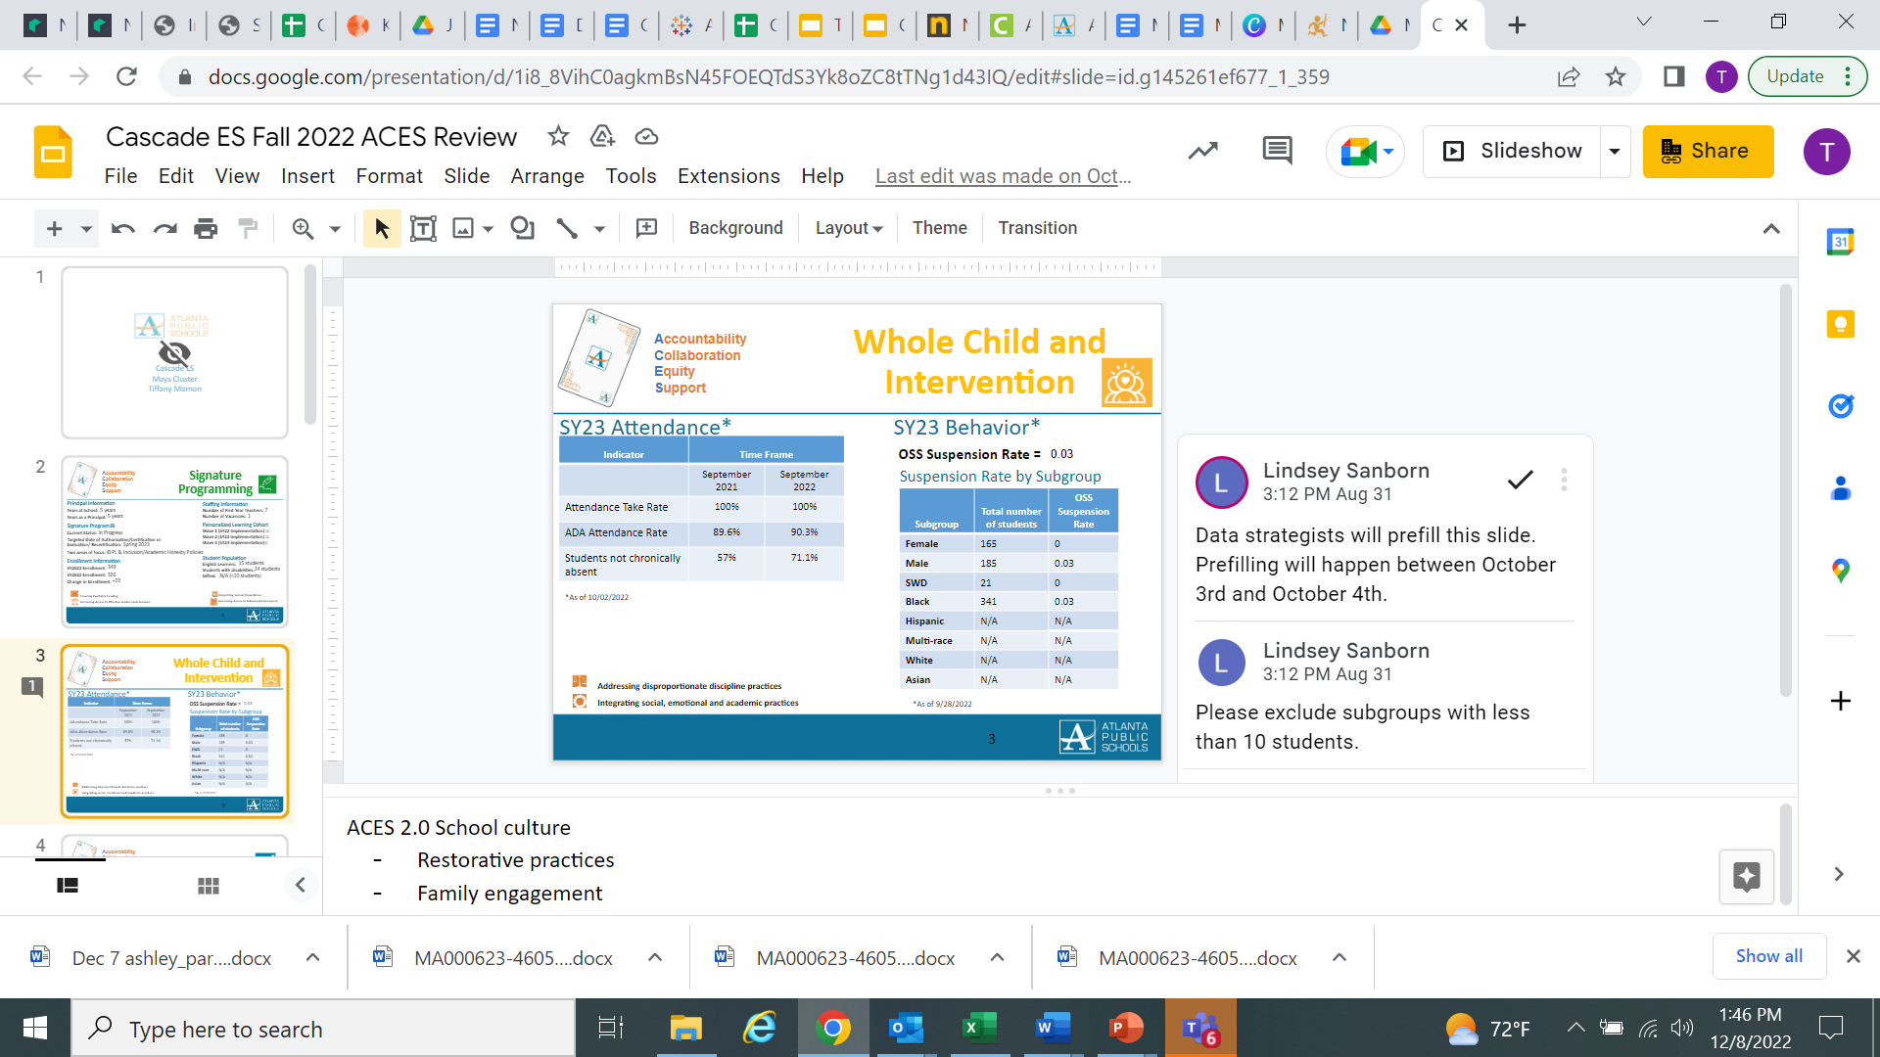
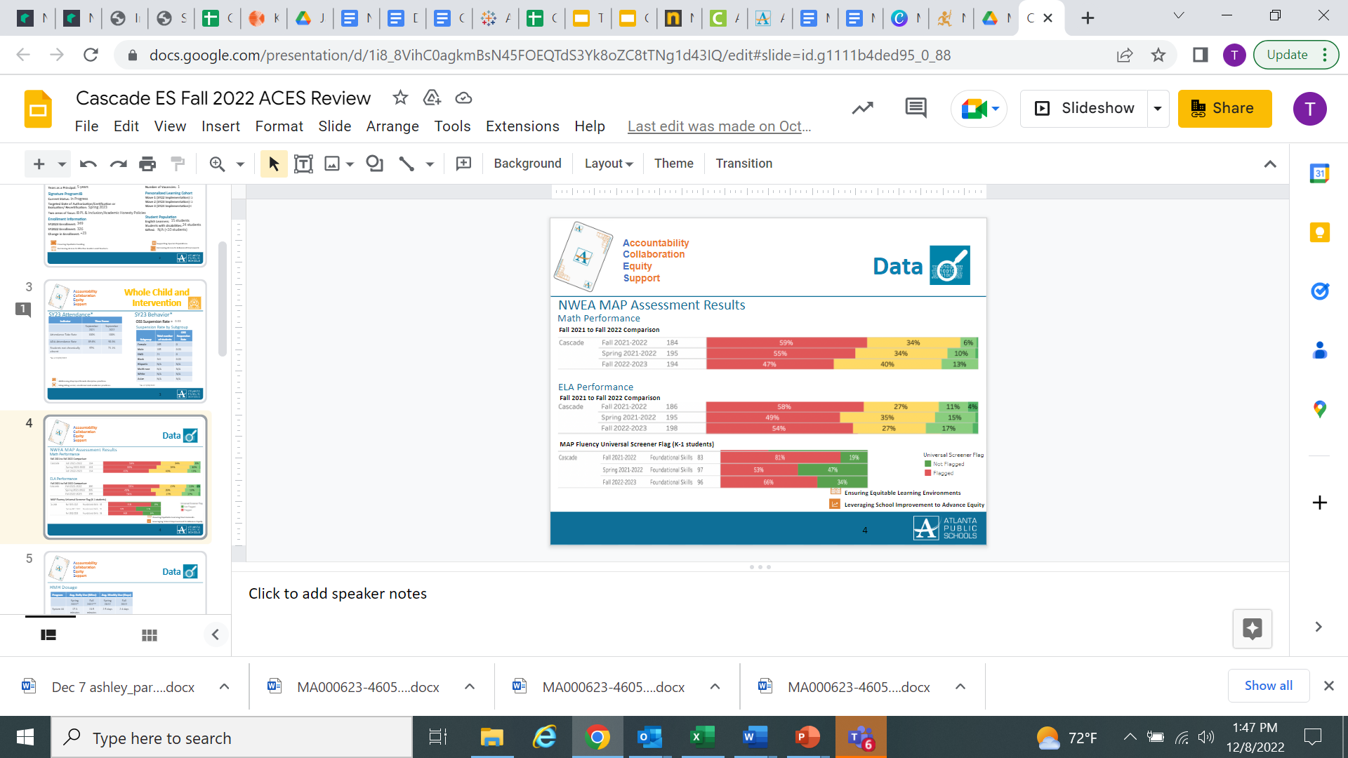
Cascade Fall ACES Presentation
Slide #1
Slide #2
Slide #3

Slide 5
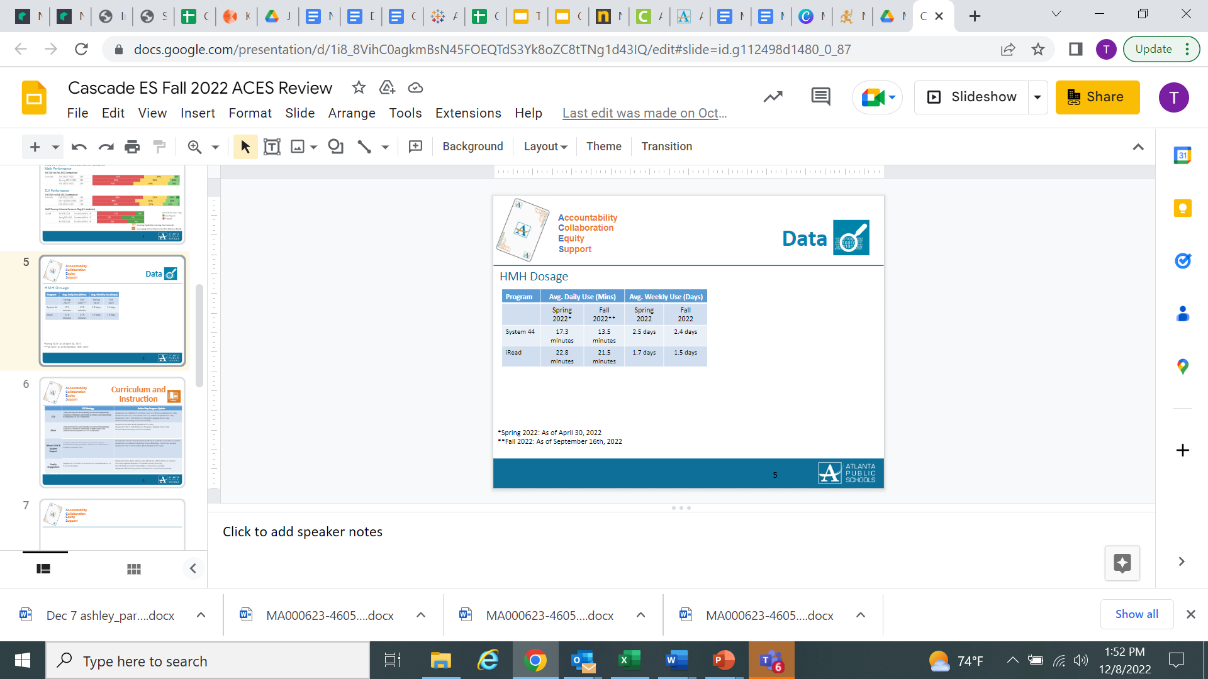
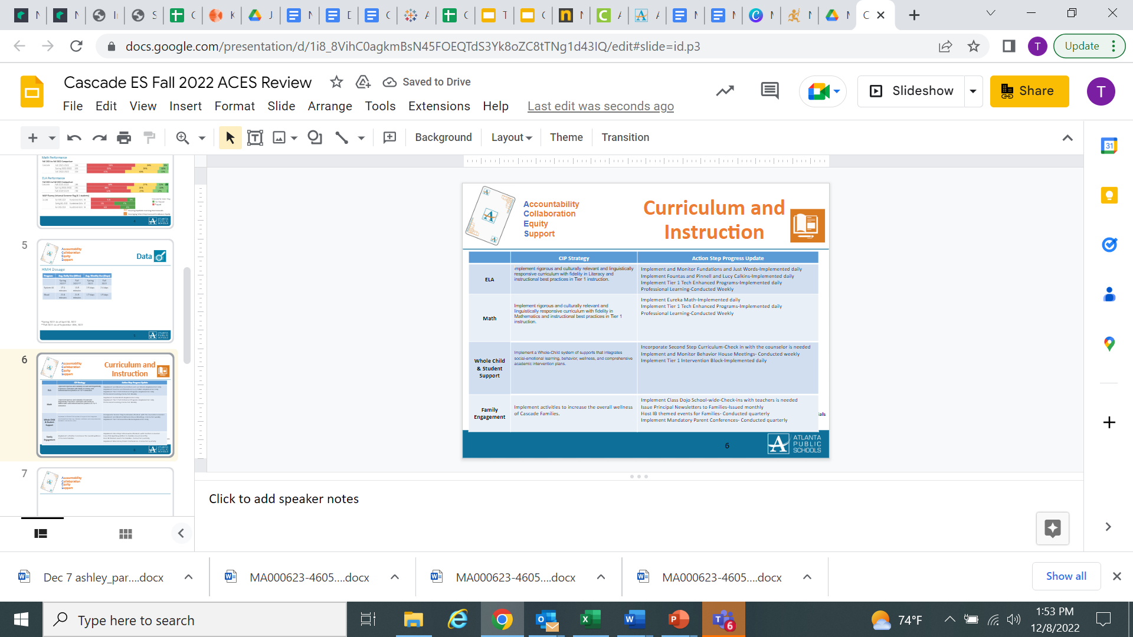
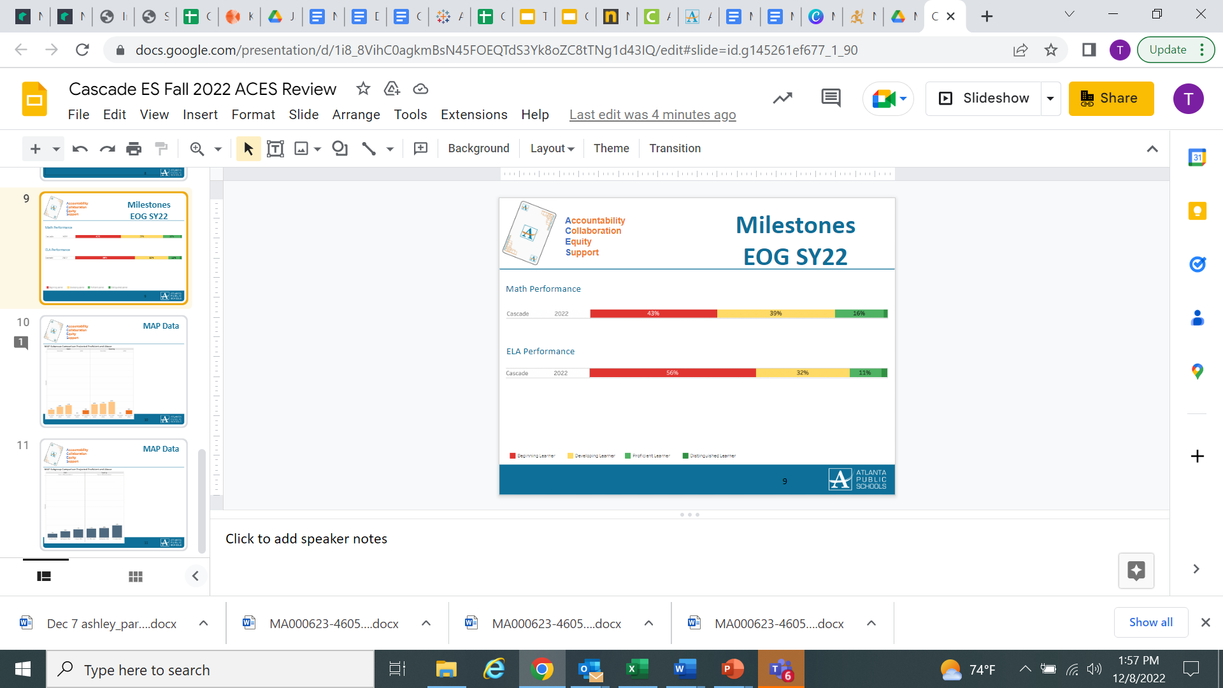
Cascade Fall ACES Presentation
Slide #4
Slide #5
Slide #6

Slide 6
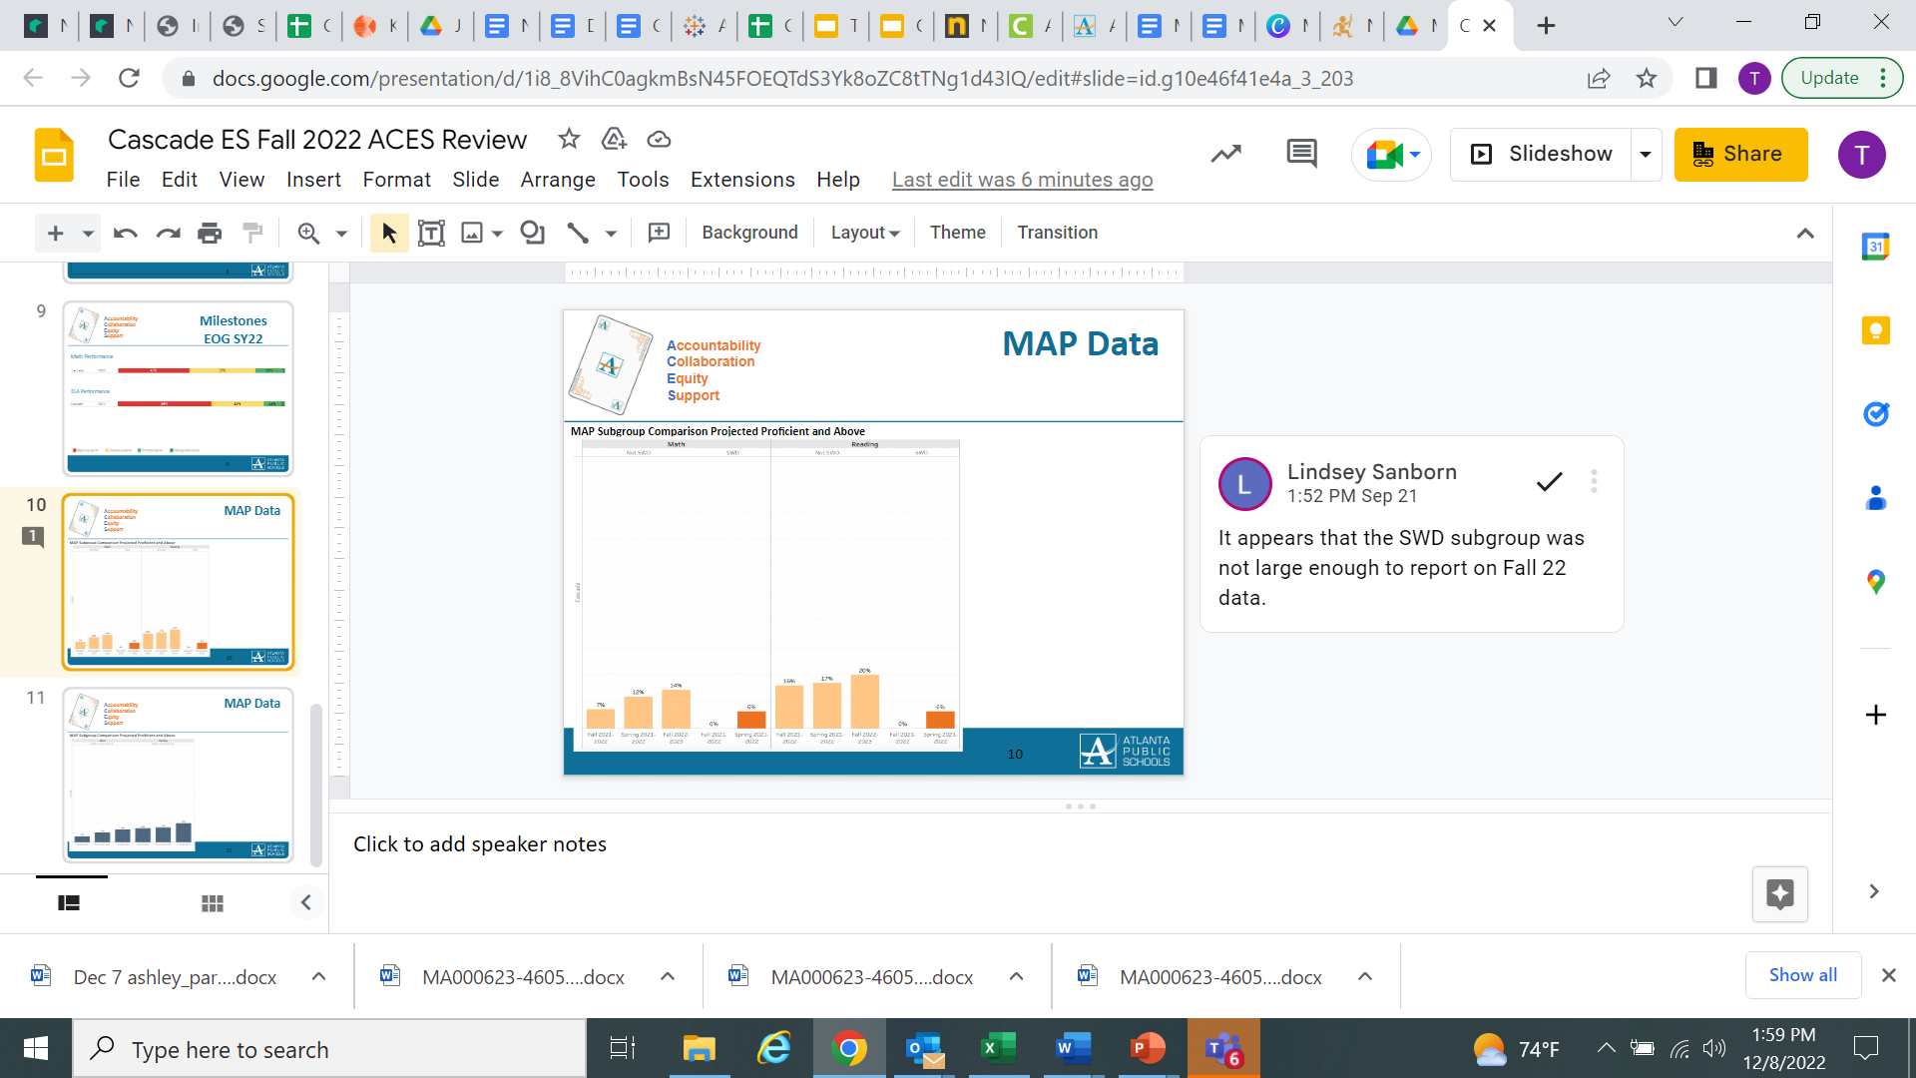
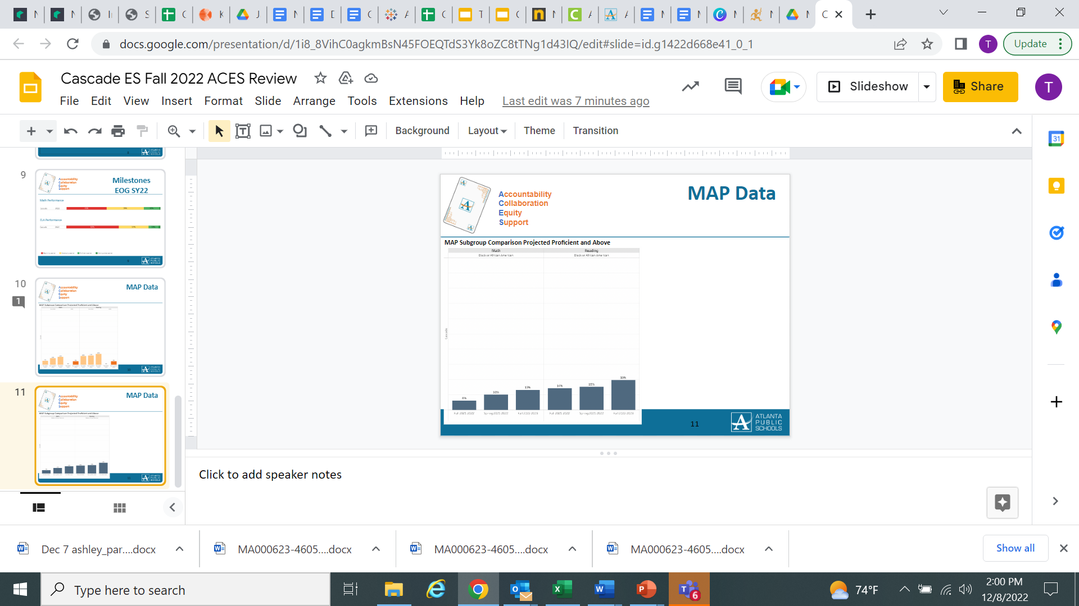
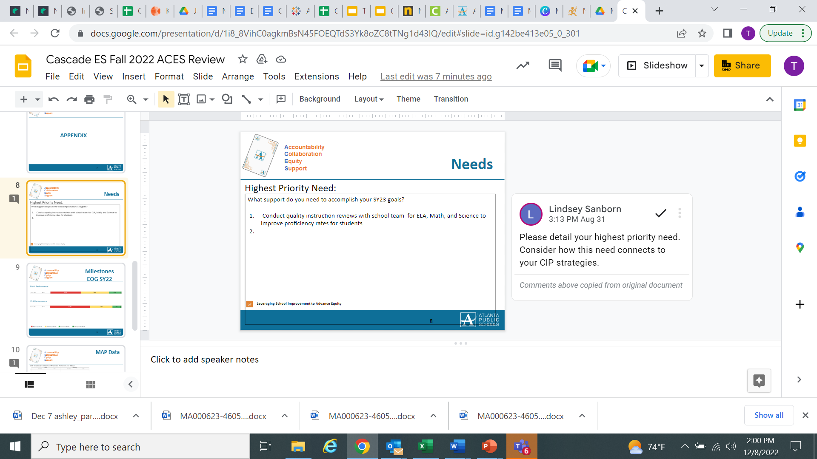
Cascade Fall ACES Presentation
Slide #7
Slide #8
Slide #9

Slide 7
Strategic Plan Progress

Slide 8
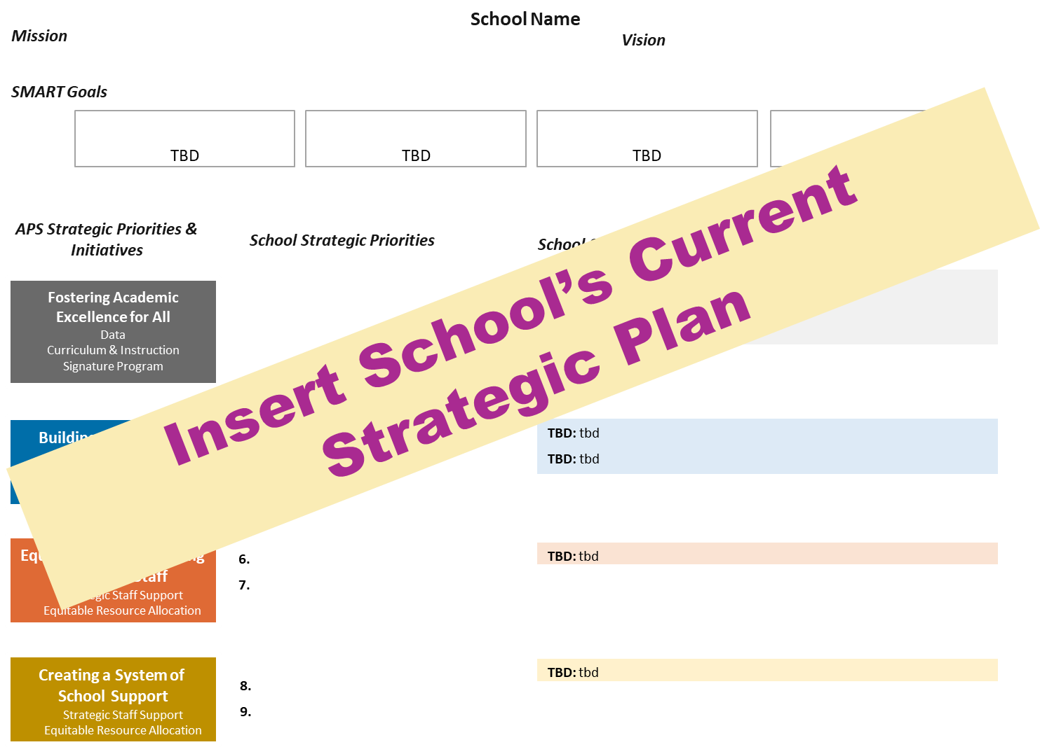
Our Strategic Plan

Slide 9
Mission
Cascade Elementary School
2024 Strategic Plan
Vision
To prepare students for life, college and careers by providing rigorous, equitable, culturally relevant
And real world learning experiences in order to become fully engaged and realized citizens of the
Global community.
To become the premier elementary school within Southwest
Atlanta that provides students with a broad and balanced education.
SMART Goals
Improve the proficiency rates of students in grades 3-5 by 6% in ELA by June 2024 on the GA Milestones
Improve the proficiency rates of students in grades 3-5 by 6% in Math by June 2024 on the GA Milestones
Improve family wellness survey question to exceed a 3.94 rating
TBD
APS Strategic Priorities
& Initiatives
School Strategic Priorities
School Strategies
Fostering Academic
Excellence for All
Data
Curriculum & Instruction
Signature Program
Improve the percent of students achieving at the proficient and distinguished levels on the GA Milestones
Improve Tier 1 instructional strategies in ELA & Mathematics
Improve early identification procedures for Tier 2 and above
a; School wide implementation of Fundations, Lucy Calkins, and Eureka Math
b; Provide professional learning sessions focused on curricular programs
2. Conduct weekly data meetings and rehearsals focused on tier 1 content
3. Retain an intervention specialist to oversee protocols and instruction for Tier 2 and above
Building a Culture of
Student Support
Whole Child & Intervention Personalized Learning
4. Become an authorized IB PYP World School by 2023
5. Continue to implement a Tier 1 intervention block for ELA & Math
4. Conduct professional learning sessions designed to increase program awareness and philosophies
5. Observe and monitor the implementation of Tier 1 instructional block
Equipping & Empowering
Leaders & Staff
Strategic Staff Support
Equitable Resource Allocation
6. Build teacher capacity using effective instructional coaching strategies
7. Increase the amount of certifications and endorsements among staff
6. Retain a Turn Around Reading Specialist and Math Master Teacher Leader to support teachers with instructional strategies
7. Promote certification and endorsement opportunities in staff communications
Creating a System of School Support
Strategic Staff Support
Equitable Resource Allocation
8. Create a positive healthy school environment where students thrive, teachers enjoy coming to work, and the community trusts
8. Conduct weekly house meetings and monthly events for families to engage in

Slide 10
Action on the Updated Strategic Plan
The GO Team needs to TAKE ACTION (vote) on its updated Strategic Plan. After the motion and a second, the GO Team may have additional discussion. Once discussion is concluded, the GO Team will vote.

Slide 11
Preparing for
Budget Development

Slide 12
Discussion
Strategic Plan Priority Ranking
In preparation for the 2023-2024 Budget Development (January–March 2023), the GO Team needs to rank its Strategic Plan Priorities. Use the next slide to capture the priority ranking.

Slide 13
Strategic Plan
Priority Ranking
Insert the school’s priorities from Higher to Lower
Higher
8. Create a positive healthy school environment where students thrive, teachers enjoy coming to work, and the community trusts
2. Improve Tier 1 instructional strategies in ELA & Mathematics
3. Improve early identification procedures for Tier 2 and above
Improve the percent of students achieving at the proficient and distinguished levels on the GA Milestones
4. Become an authorized IB PYP World School by 2023
Continue to implement a Tier 1 intervention block for ELA & Math
6. Build teacher capacity using effective instructional coaching strategies
7. Increase the amount of certifications and endorsements among staff
Lower

Slide 14
Action on the
Strategic Plan Priorities
The GO Team needs to TAKE ACTION (vote) on its ranked Strategic Plan Priorities. After the motion and a second, the GO Team may have additional discussion. Once discussion is concluded, the GO Team will vote.

Slide 15
Where we’re going
At our next meeting we will begin the discussion of the 2023-2024 budget.
Let me or the Chair know of any additional information you need for our future discussion.

Slide 16
Thank you

